Slide 2
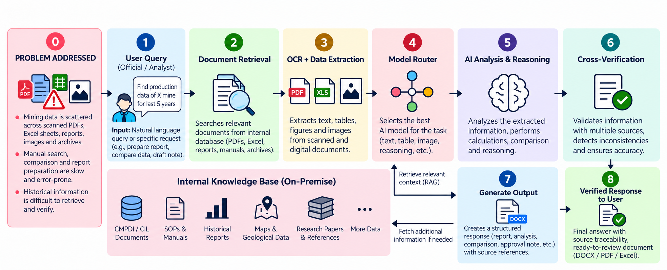
ARIA: Offline AI for Evidence-Backed Mining Intelligence
NEXUS_ALPHA
Problem:
Geological, mining and production data is scattered across scanned PDFs, documents, spreadsheets, images and archives.
Reports and parliamentary/high-priority queries require extensive manual searching and compilation.
Manual data extraction leads to errors and inconsistencies.
Historical information is difficult to retrieve, creating dependency on individual expertise.
There is no secure, intelligent platform for automated document processing, validation, retrieval and reporting.
Proposed Solution:
100% Local / Offline AI — Processes documents, queries and outputs entirely within the organization.
AI Document Intelligence — Extracts information from scanned and digital documents automatically.
Automated Report Generation — Converts verified data into structured reports and official documents.
Evidence-Based Query System — Answers questions with source-level traceability and verification.
Word Cloud & Topic Identification — Surfaces recurring terms and emerging themes across the document archive.
Innovation & Uniqueness:
Evidence-Provenance AI — Traces answers and figures to source documents, pages and tables.
Cross-Document Validation — Compares data across reports, spreadsheets and historical records.
Contradiction Detection — Flags conflicting figures instead of generating unsupported answers.
Agentic Model Chaining — Combines specialized models and tools for complex tasks.
Institutional Knowledge Base — Converts historical archives into a searchable knowledge base.
@SIH Idea submission
2

Slide 3
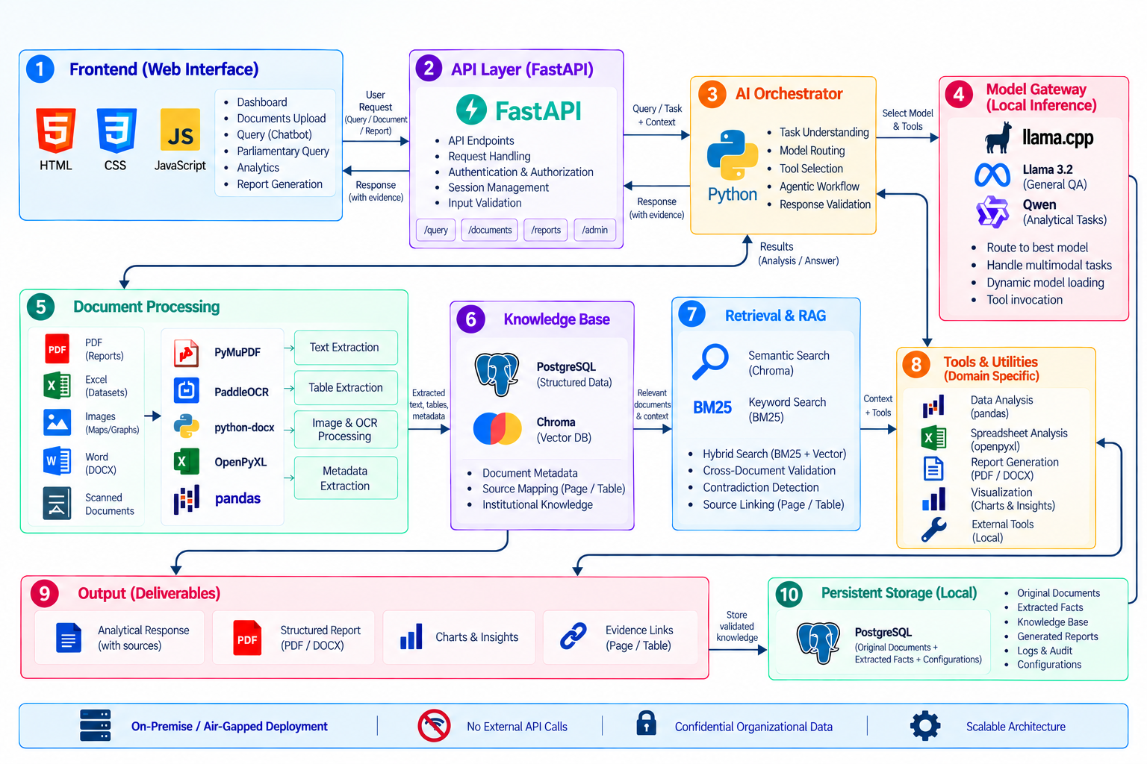
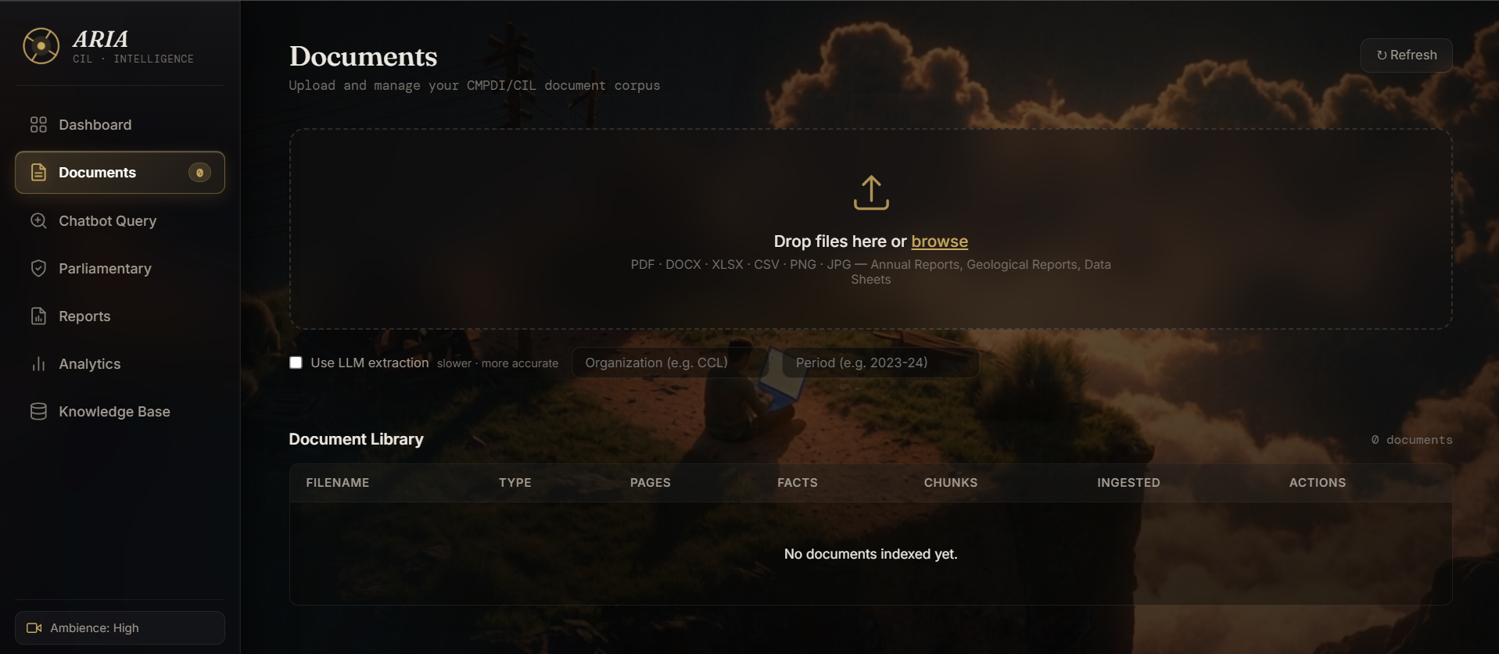
TECHNICAL APPROACH
NEXUS_ALPHA
Proposed Technical Stack
AI / Models
Open-weight LLMs — Llama / Qwen
Local Vision & OCR models
Local embedding model
Specialized extraction/reasoning models
Backend / AI Orchestration
Python + FastAPI
Agent / Model Router, AI Orchestrator
Local LLM inference using llama.cpp
Knowledge & Data
PostgreSQL — structured data
FAISS / Chroma — vector database
BM25 + Vector Search — Hybrid RAG
Document metadata & provenance store
Document Processing
PaddleOCR
python-docx , PyMuPDF , Openpyxl
Pandas
Frontend
HTML , CSS , JavaScript
Security & Infrastructure
Local GPU Server
Private / Air-Gapped Network
Working Prototype:
The prototype demonstrates local/offline AI, hybrid RAG, multimodal document processing, validation, evidence traceability, and automated report generation for CMPDI/CIL workflows.
3
@SIH Idea submission

Slide 4
FEASIBILITY AND VIABILITY
NEXUS_ALPHA
Feasibility:
Open-weight models are available in various platforms such
as Hugging Face
Existing technologies support LLMs, OCR, Vision, RAG and agentic workflows.
PyMuPDF, PaddleOCR, Openpyxl and python-docx support the required document formats.
Modular architecture allows new specialized models to be integrated without redesigning the platform.
Hybrid retrieval combines exact keyword matching with semantic search for document intelligence.
Viability:
Protects organizational data through local/on-premise AI processing. .
Automates repetitive document analysis, data extraction and report generation.
Provides a centralized institutional knowledge base from historical and current documents.
Supports faster responses to parliamentary and high-priority administrative inquiries.
Scales from a single local workstation → subsidiary deployment → organization-wide AI infrastructure.
Challenges | Solution to Overcome
GPU/RAM limitations | Use quantized models and dynamic loading to optimize resources.
AI hallucinations | Ground responses with local RAG, verification and human review.
Conflicting production figures | Auto-resolves using a source-priority hierarchy, citing the authoritative source.
Numerical extraction errors | AI Extraction — Validates numerical data during extraction.
Large historical archives | Institutional Knowledge Base Organizes large historical archives.
Complex / poor-quality documents | Combine OCR + Vision, preprocessing and validation.
@SIH Idea submission
4

Slide 5
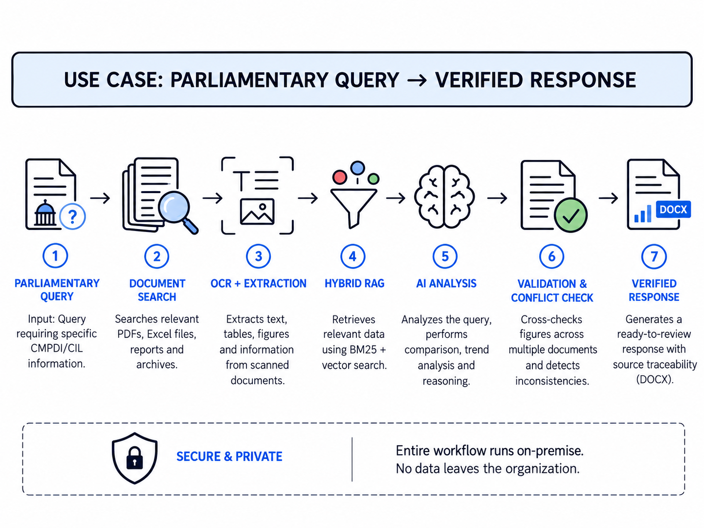
IMPACT AND BENEFITS
NEXUS_ALPHA
Potential Impact
CMPDI / CIL — faster analysis of geological, mining and production records.
Ministry of Coal — quicker parliamentary and high-priority responses.
Officials & Analysts — automated extraction, validation and report preparation.
Government Operations — standardized reporting and faster information access.
Organization — preserved institutional knowledge with secure offline AI.
Use Case: Parliamentary Query → Evidence-Backed Response
Scenario:
“Provide the production of Coal India subsidiaries for the last 5 years, compare the figures, and explain the major changes.”
Benefits
Faster Reporting — reduces time spent on document analysis and report preparation.
Reduced Manual Work — automates repetitive extraction, comparison and reporting tasks.
Secure AI Processing — keeps sensitive CMPDI/CIL data within the local infrastructure.
Faster Decision Support — provides verified information with source-level traceability.
Preserved Institutional Knowledge — makes historical records searchable and reusable.
Improved Accuracy — validates and identifies conflicts in data.
.
All processing happens locally — confidential CMPDI/CIL information never leaves the organization's infrastructure.
From scattered historical records to an evidence-backed response — entirely on-premise.
@SIH Idea submission
5

Slide 6
RESEARCH AND REFERENCES
NEXUS_ALPHA
Research & References:
Ministry of Coal – Annual Reports — Production, distribution, exploration, safety, R&D and coal-sector information.
Ministry of Coal – Coal Statistics — Coal Directory datasets and statistical reports.
CMPDI – Annual Reports — CMPDI annual reports and organizational/technical information.
Ministry of Coal – R&D Report — Coal-sector R&D activities and CMPDI's role in coordinating research.
Technical References:
FAISS – Facebook AI Research — Dense-vector similarity search and retrieval.
PaddleOCR – Official Repository — OCR, document parsing and table recognition.
PyMuPDF Documentation — PDF extraction and processing.
python-docx Documentation — Automated Word-document generation.
OpenPyXL Documentation — Excel processing and structured-data extraction.
Future Improvements:
Confidence Firewall — automatically flags uncertain or high-risk outputs for human review.
Sovereign AI Federation — securely connects multiple isolated ARIA deployments without sharing confidential data.
Organizational Memory Graph — connects historical reports, equipment, SOPs, incidents and maintenance records.
Offline AI Marketplace — securely imports approved models, tools and workflows into air-gapped environments.
AI Cluster Scaling — distributes workloads across multiple local AI servers based on availability and task requirements.
Digital-Twin Intelligence — combines ARIA's knowledge with operational data for predictive maintenance and decision support.
Evidence Integrity — stores cryptographic hashes of source documents and generated reports to detect tampering.
YouTube Demo Link: https://youtu.be/mYemqU1wmE4
@SIH Idea submission
6

